Slide 1
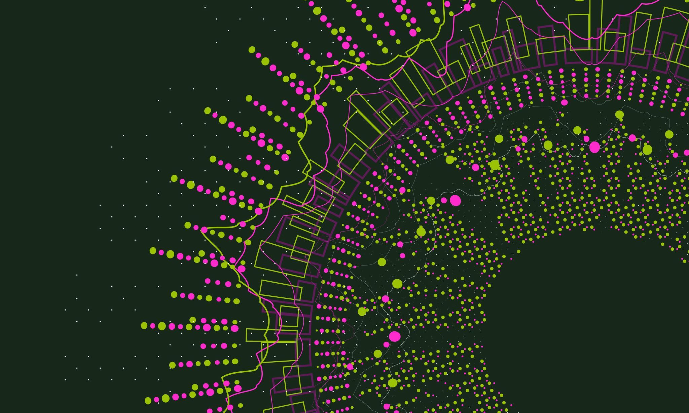
Windows Virtual Assistant

Slide 2

Title: Windows Virtual Assistant
A Windows-based AI Companion
By Asif Erfan Khan
Roll No: 515

Slide 3
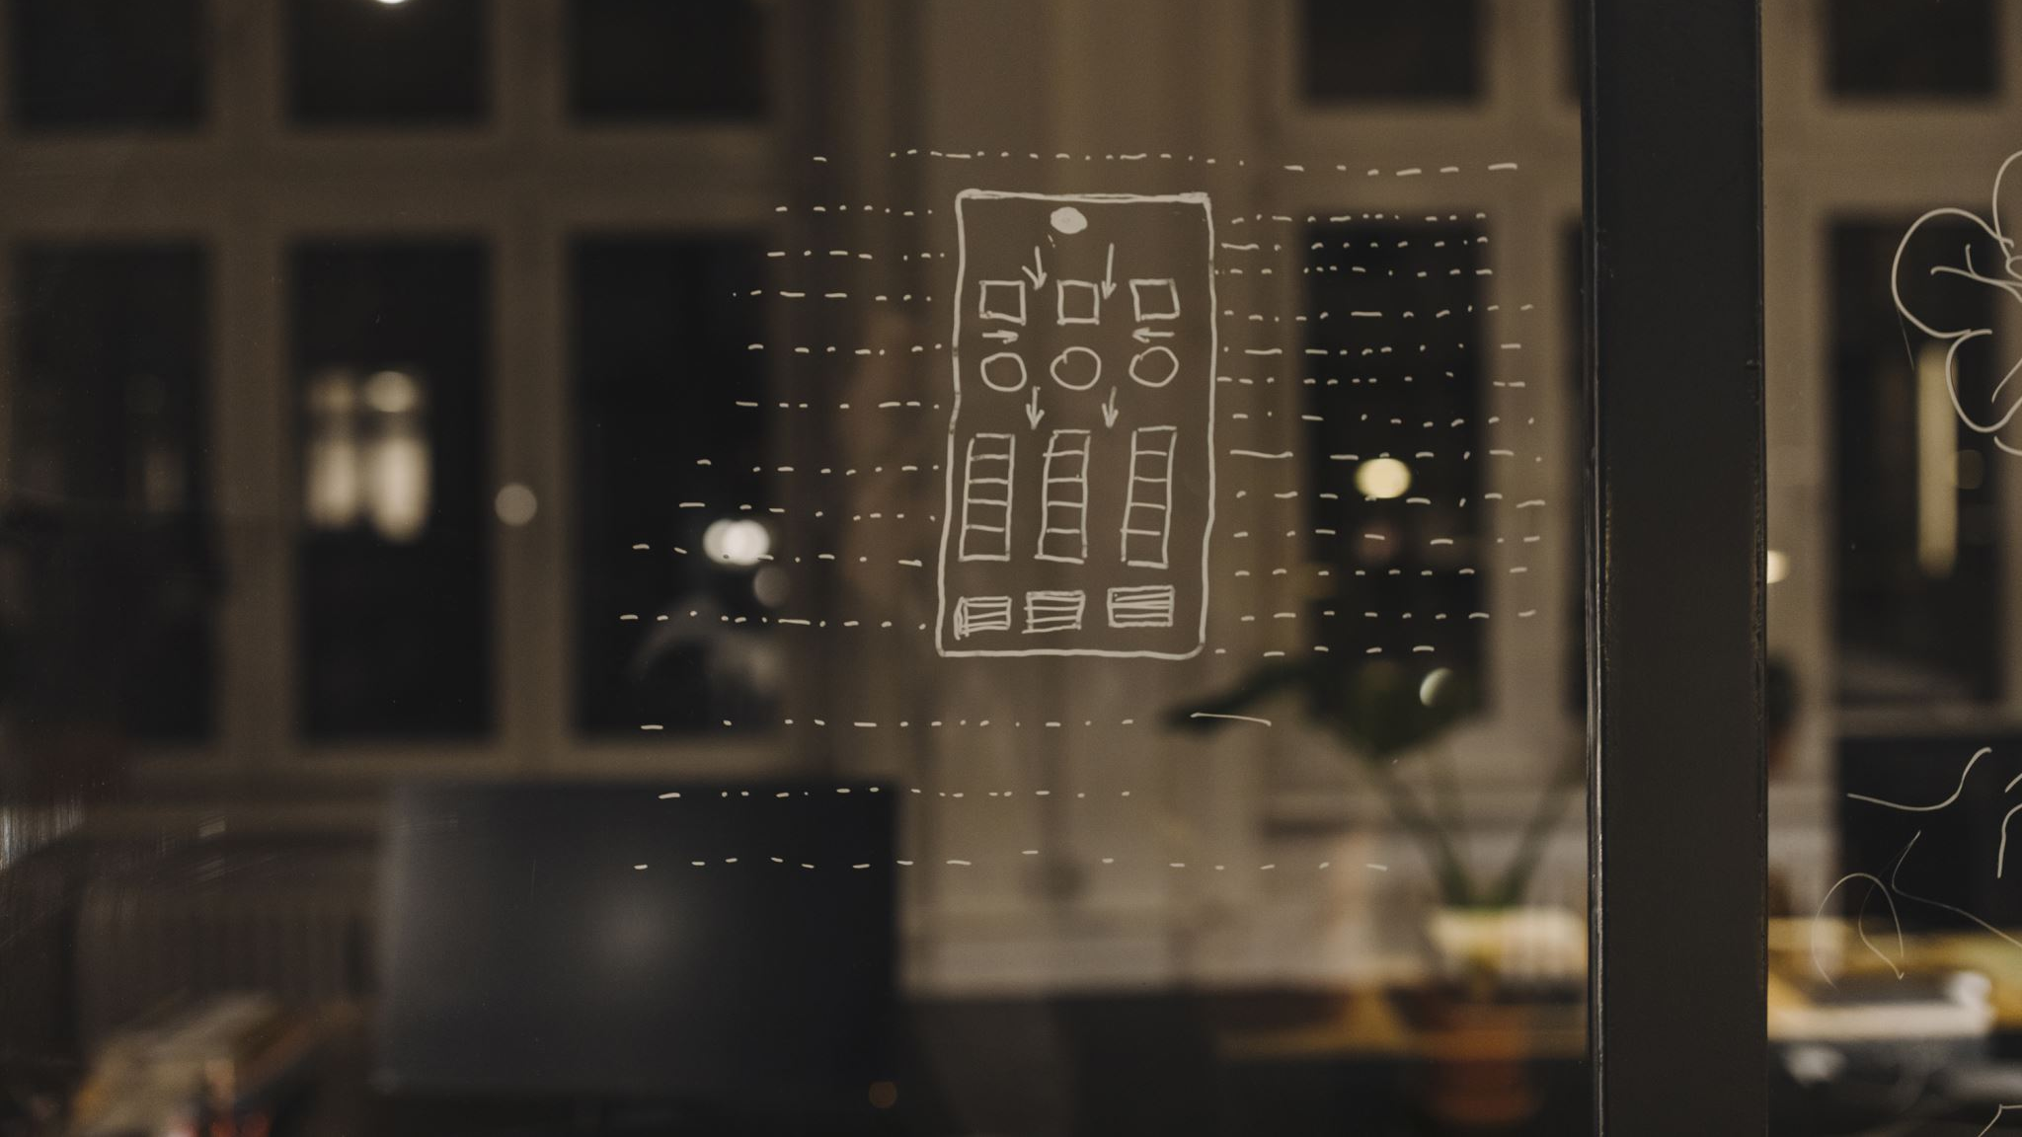
Why was this project created in the first place?
Purpose of the Assistant: “The purpose of this project is to assist you with various tasks and provide information quickly and efficiently."
Key Feature
Designed for Microsoft Windows: "Built to seamlessly integrate with the Windows operating system for optimal performance and accessibility."

Slide 4
Capabilities
What Can I Do?
Features and Functions
Content

Slide 5

Capabilities
Voice Interaction: "Interact with me using voice commands for hands-free operation and convenience."
Web Browsing: "Access popular websites such as YouTube, Google, Reddit, and more with a simple voice command."
News Retrieval: "Stay updated with the latest news by asking me to fetch and read headlines from various sources."
Time and Date Information: "Get instant time and date information just by asking, keeping you on track throughout the day."

Slide 6

Voice Commands
Interact Seamlessly
Open Popular Websites: "Easily navigate to your favorite websites like YouTube, Google, Reddit, and others using voice commands."
Access Productivity Tools: "Open essential productivity tools like the Microsoft Office Suite and Notepad to streamline your workflow."
Open Media Players and Editing Software: "Launch media players such as VLC Media Player and editing software like Camtasia with simple voice commands for entertainment and productivity."

Slide 7

Additional Features
Email Sending Functionality: "Send emails effortlessly by dictating the recipient, subject, and content, making communication efficient."
News Retrieval and Reading: "Stay informed on the go with the ability to retrieve and listen to the latest news headlines."
Integration with Generative AI: "Engage in natural conversations and receive responses generated by advanced AI, enhancing the user experience."

Slide 8

Conclusion
Farewell Message: I hope I will be able to assist you with your tasks today. If you'd like to learn more, I'm always happy to help you search the web. Until then, have a wonderful day!
*Created by AI itself!*

